Slide 1

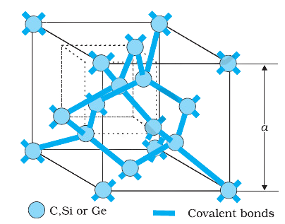
Semiconductors - Infographics
STD XII Physics
Diamond-like lattice structure for Carbon, Silicon, or Germanium
www.saitechinfo.com

Slide 2
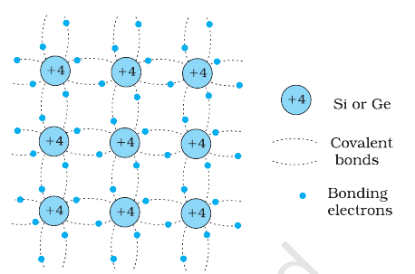
Semiconductors - Infographics
STD XII Physics
Schematic representation of Si/Ge structure showing covalent bonds
www.saitechinfo.com

Slide 3
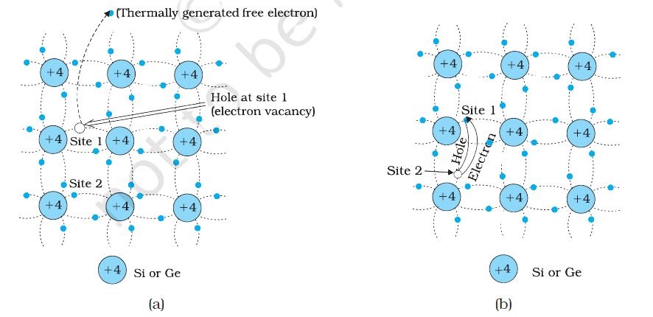
Semiconductors - Infographics
STD XII Physics
Thermal motion and generation of holes
www.saitechinfo.com

Slide 4
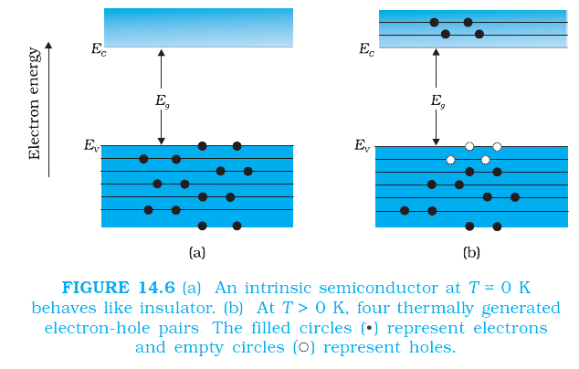
Semiconductors - Infographics
STD XII Physics
Energy band positions in a semiconductor
Electrons
Holes
www.saitechinfo.com
T = 0 K
T > 0 K

Slide 5
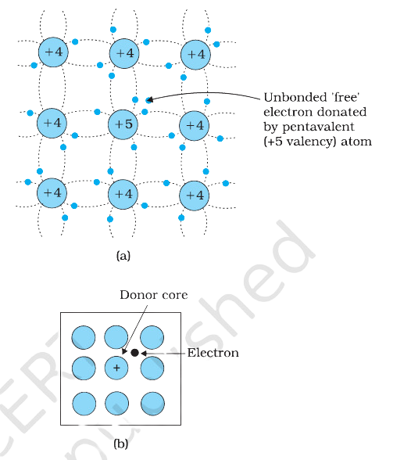
Semiconductors - Infographics
STD XII Physics
Energy band difference in metals, insulators, and semiconductors
Donor Core
Unbonded ‘Free ‘ electron donated by pentavalent atom
Electron
www.saitechinfo.com

